Slide 1
Title IX & Sexual Harassment- 2025
Sherry Cox, Executive Director of Human Resources/Title IX Coordinator
Scott Johnson, Associate VP of Instructional Support & Student Services/Deputy Title IX Coordinator

Slide 2
Title IX (TIX) Main Text
No person in the United States shall, on the basis of sex, be excluded from participation in, be denied the benefits of, or be subjected to discrimination under any education program or activity receiving federal financial assistance.”
20 U.S.C. § 1681

Slide 3
Title IX…
A federal law intended to end sex discrimination in all areas of education | Applies to issues of program equity, such as in athletics
Sexual harassment is a form of sex discrimination prohibited under Title IX

Slide 4
What is Sexual Harassment?
Sexual Harassment is a broad term to describe conduct of a sexual nature that is prohibited.
This includes but is not limited to:
You have the right to be free from all forms of Sexual Harassment
Quid Pro Quo…conditioning aid, benefit, or service on an individual’s participation in unwelcome sexual conduct | Unwelcome Conduct that is so severe, pervasive, and objectively offensive that it denies equal access to education program
Sexual Assault | Dating Violence
Domestic Violence | Stalking
WCC Title IX Policy/Procedure

Slide 5
Reporting Sexual Misconduct
WCC strongly encourages all employees and other members of the WCC community to promptly report concerns regarding suspected or known discrimination/harassment on the basis of sex to the Title IX Coordinator or a Deputy Title IX Coordinator.
Employees | Sherry Cox Executive Director of Human Resources/Title IX Coordinator (336) 838-6422 spcox072@wilkescc.edu
Students | Scott Johnson Associate Vice President of Instructional Support & Student Services/ Deputy Title IX Coordinator (336) 838-6141 sajohnson366@wilkescc.edu

Slide 6
Confidential Resources
Michael Roope, LCMHC Student Services Office (336) 838-6147 msroope085@wilkescc.edu
Amber Cook, LCSWA Student Services Office (336) 838-6229 alcook636@wilkescc.edu

Slide 7
Online and Remote Harassment
Title IX protections apply to WCC’s virtual environments (email, Teams, Moodle).
Examples of online misconduct:
Inappropriate private messages
Unwanted comments during virtual class
Misuse of shared documents for harassment
Document and report digital misconduct like in-person behavior.

Slide 8
Title IX: Pregnancy and Childbirth
Title IX regulations prohibit discrimination against a student based on pregnancy or related conditions. Pregnancy or related conditions includes:
Childbirth
Termination of Pregnancy
Lactation
Related medical conditions or recovery
Students seeking supports and/or accommodations related to pregnancy or childbirth should complete the Pregnancy/Childbirth Notification & Support Request Form.
Questions: Renee Macemore (336-838-6560 or rmmacemore052@wilkescc.edu)

Slide 9
More Details
Syllabus Template
www.wilkescc.edu/prevent
Title IX Sex Discrimination & Harassment Policy
Sex Discrimination & Harassment Report Form
Resource Information
www.wilkescc.edu/prevent

Slide 10

www.wilkescc.edu/prevent

Slide 11

www.wilkescc.edu/prevent

Slide 12

Title IX only applies to students.
Fact: It applies to students, staff, and faculty.
www.wilkescc.edu/prevent

Slide 13
If a student doesn’t ask you to report, you shouldn’t.
Fact: WCC strongly encourages all employees and other members of the WCC community to promptly report concerns regarding suspected or known discrimination/harassment on the basis of sex to the Title IX Coordinator or a Deputy Title IX Coordinator.
The President, Vice Presidents, & Deans are required to report discrimination and harassment on the basis of sex to the Title IX Coordinator or a Deputy Title IX Coordinator.
www.wilkescc.edu/prevent

Slide 14

Supportive measures are only for the person who filed a formal complaint.
Fact: Supportive measures are available for both the complainant and responding party.
www.wilkescc.edu/prevent

Slide 15
Supportive Measures
Title IX requires that supportive measures be non-disciplinary, non-punitive, and designed to restore or preserve access to education.
Available to both complaint and respondent.
Examples:
Academic extensions or schedule adjustments
Change in class section
Campus no-contact orders
Counseling
Increased campus security
www.wilkescc.edu/prevent

Slide 16
Discussion
What would you say to a student who begins disclosing a Title IX concern during class or office hours?

Slide 17
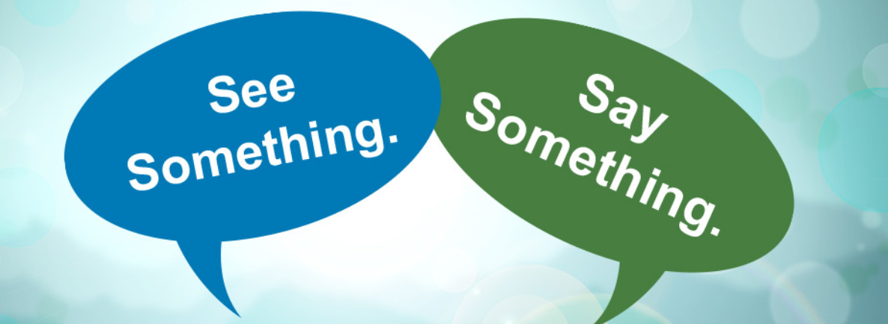
Case Study #1
Kim reports to her instructor that another student in the class, Adam, is harassing her. She says he sent her a message on Facebook that had sexual wording. She has blocked him from her Facebook account. However, the incident has scared her very much. She says that she doesn’t want to get Adam in trouble, but she doesn’t want to feel uncomfortable either.

Slide 18
Case Study #2
Instructor Knight assigned a reflective essay to her class. When reviewing the submitted essays, Instructor Knight came across an essay written by a student named Elisabeth. In her essay, Elisabeth detailed an ongoing situation with a male classmate in another course. She described how the classmate had been making her feel uncomfortable with repeated advances, inappropriate comments, and unwanted physical contact. Elisabeth explained that she was afraid to report the incidents, fearing it would escalate the situation.

Slide 19
Case Study #3
Morgan is pregnant and struggling to meet assignment deadlines due to severe morning sickness. She informs her instructor and requests some flexibility. The instructor replies that there are “no exceptions” for absences or late work.
Morgan feels penalized for her medical condition.

Slide 20
QUIZ
How Much Do You Know?

Slide 21
What is Title IX?
How Much Do You Know?

Slide 22
What is a form of Sexual Harassment?
How Much Do You Know?

Slide 23
Who is the Title IX Coordinator or Deputy Title IX Coordinator?
How Much Do You Know?

Slide 24
Who is a confidential resource on campus?
How Much Do You Know?

Slide 25
Where is one of the designated lactation spaces on campus?
How Much Do You Know?

Slide 26
Thank You

